Slide 1
HLS In Depth

Slide 2
What is HLS?
HTTP Live Streaming (HLS) sends audio and video over HTTP from an ordinary web server for playback on iOS-based devices—including iPhone, iPad, iPod touch, and Apple TV—and on desktop computers (macOS). Using the same protocol that powers the web, HLS deploys content using ordinary web servers and content delivery networks. HLS is designed for reliability and dynamically adapts to network conditions by optimizing playback for the available speed of wired and wireless connections.
Notes:
In the App Store, if you produce an app that delivers video longer then ten minutes or greater than 5MB of data, you must use HTTP Live Streaming.

Slide 3
What does HLS Support?
Live broadcasts and prerecorded content (video on demand, or VOD)
Multiple alternate streams at different bit rates
Intelligent switching of streams in response to network bandwidth changes
Media encryption and user authentication

Slide 4
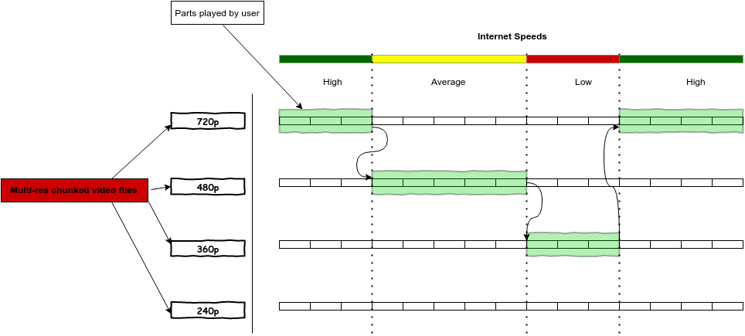
Adaptive Video Streaming
Notes:
Problem - User wants that the video must play seamlessly on different devices with different internet speeds and for obvious reasons that won’t be possible if in case you are having an HD video and the user is playing it on a 2G network.
Adaptive Streaming(stream media content over HTTP protocols) - The basic idea behind adaptive streaming is to generate various versions of the media file for different bitrates and resolutions and then choosing one of them based according to user’s bandwidth, screen size etc. Those different bitrate versions are split into multiple chunks that are then played according to the user’s bandwidth. Common protocols based on this idea are Apple’s HLS, MPEG-DASH, Adobe HTTP dynamic streaming, etc.
As an HTTP-based technology, no streaming server is required, so all the switching logic resides on the player.

Slide 5
HTTP Live Streaming Architecture
HTTP Live Streaming consists of three parts:
Server Component
Distribution Component
Client Software.

Slide 6
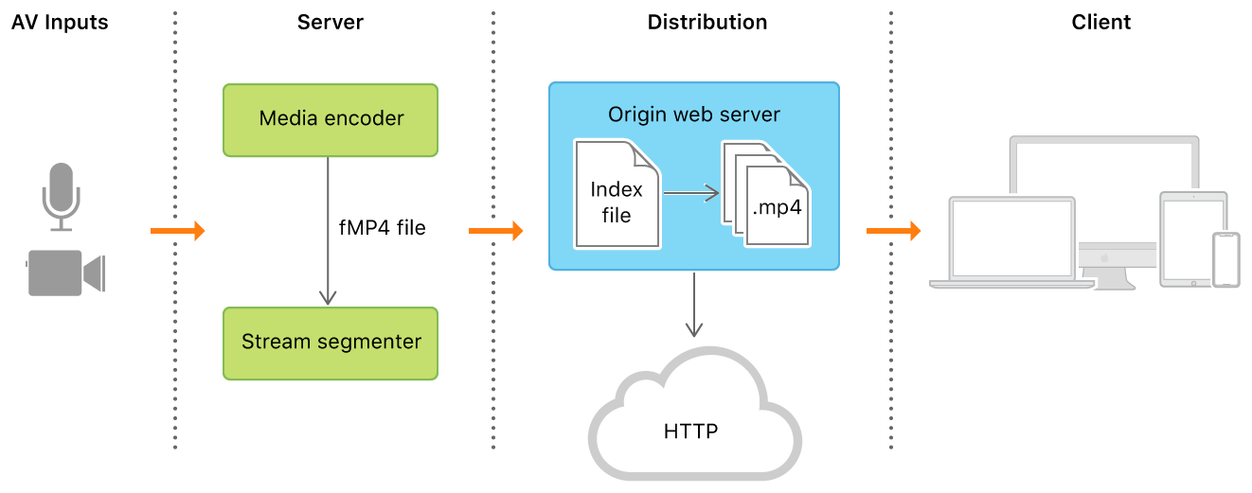
How it all works?
Notes:
Media Encoder - Compresses original content and outputs an

Slide 7
Server(Encode + Transcode + Segment)
Media Encoder In HLS - takes audio-video input from source, encodes it as HEVC or H.264 video and AAC or AC-3 audio, and outputs a fragmented MPEG-4 file or an MPEG-2 transport stream.
Stream Segmenter - breaks the stream into a series of short media files, which are placed on a web server. The segmenter also creates and maintains an index file(.m3u8) containing a list of the media files.
Notes:
Server Component - Input stream of media -> (Encode them digitally + Create multiple bitrate streams) -> Create segments or chunks(.ts)
Encoder - are hardware devices or a software that convert data from one format to another using a standard codec(compression/decompression mechanism). source feed(from your camera) -> streamable(compressed) data format. Examples of S/W Encoders - Telestream WireCast(https://www.telestream.net/wirecast/), vMix(https://www.vmix.com/), Handbrake(https://handbrake.fr/), Open Broadcaster Software(https://obsproject.com/) and XSplit(https://www.xsplit.com). H/W Encoders - Teradek Beam(https://www.teradek.com/collections/beam-family), NewTek Tricaster(https://www.newtek.com/tricaster/8000/) etc.
Generally, for large scale live events people use Hardware Encoders(dedicated processors for codec) to ensure low latency.
Codec(Coder + Decoder) - software/process which creates a compressed audio/video stream. Target client(player) is responsible for decoding the same.
H.264(AVC: Advanced Video Coding, MPEG-4 Part 10) - Most widely supported video codec, better bitrate than H.263 for the same file size.
H.265(HEVC: High Efficiency Video Coding) - Compression rate is almost double that of H.264, Half the bitrate of H.264, ~50% smaller file size compared to H.264, Good for high resolutions(> 2K, supports upto 8K ultra HD) and live streaming, requires around three-times the resources for encoding, compatible with macOS v10.13 or later, iOS 11 or later, and tvOS 11 or later, proprietary codec(royalty associated with usage)
Both H.264, H.265 have their open source versions i.e. x.264 and x.265 resp.
VP9(Royalty-Free/Open-Source, Google) - Half the bitrate of VP8, Good for high resolutions(> 2K) and live streaming, requires more resources for encoding, not widely supported.
VP9(Makes streams more consistent and reliable) vs H.265(Better Image Quality)
MP3(MPEG-2 Audio Layer III) - Developed by Moving Picture Experts Group, Popular with wide support, Saves space without noticeable quality loss, Limited functionality for video.
AAC(Advanced Audio Coding) - Proprietary codec, better sound than MP3 for the same bitrate, widely supported, limit on audio channels.
AC-3(Dolby Digital Audio Codec 3) - Preserve surround sound, full range of audio channels, narrow device support as compared to AAC.
Transcoding - changing the video/audio eg. changing video frame size (resolution), frames per second, video bitrate, audio volume, audio sampling frequency, audio channels number etc. While in transmuxing you only change the way that video and audio packets are organized, eg. in HLS stream they are organized in MPEG-TS containers, in DASH in fMP4 containers.
Stream Segmenter - software such as media stream/file segmenter provided by Apple. Suggested video chunk duration is 6 seconds.
Containers(Audio + Video + MetaData) -
MP4(MPEG-4 or MPEG-4 Part 14, Wide Support)
MPEG-TS(MPEG transport system)
Protocols -
HLS(HTTP Live Streaming in 2009, based on Adaptive Bitrate)
MPEG-DASH(Dynamic Adaptive Streaming Over HTTP, Codec-Agnostic, Open-Source, International Standard)

Slide 8
Distribution(Origin web server + CDN)
Origin Web Server - system that delivers the media files and index files to the client over HTTP.
CDN(Edge Servers) - refers to a geographically distributed group of servers which work together to provide fast content delivery(cache content at the network edge) e.g. Akamai, Amazon Cloudfront, Azure CDN etc.
Notes:
The distribution system is a web server or a web-caching system that delivers the media files and index files to the client over HTTP.

Slide 9
Client(Player)
Player begins by fetching the index file, using a URL that identifies the stream(.m3u8 url). The index file, in turn, specifies the location of the available media files, decryption keys, and any alternate streams available. For the selected stream, the player downloads each available media file in sequence. Each file contains a consecutive segment of the stream. Once it has a sufficient amount of data downloaded, the player begins presenting the reassembled stream to the user.
This process continues until the player encounters the EXT-X-ENDLIST tag in the index file. If no EXT-X-ENDLIST tag is present, the index file is part of an ongoing broadcast.
Notes:
Player is responsible for determining the appropriate media to request, downloading those resources, and then reassembling them so that the media can be presented to the user in a continuous stream.
During ongoing broadcasts, the player loads a new version of the index file periodically. The player looks for new media files and encryption keys in the updated index and adds these URLs to its queue.

Slide 10
Deploying a Basic HTTP Live Stream
Requirements for deploying an HTTP Live Stream:
Either an HTML page for browsers or a client app to act as a receiver.
A web server or CDN to act as a host.
A way to encode your source material or live streams as fragmented MPEG-4 media files containing HEVC or H.264 video and AAC or AC-3 audio.

Slide 11
Demo: HLS In Action
Using Apple’s Web Server
Using Local Web Server
Example Playlists
Notes:
Demo Duration: 20-25 min
The easiest way to distribute HTTP Live Streaming media is to create a webpage that includes the HTML5 <video> tag, using an M3U8 playlist file as the video source.
Using Local Web Server -
Download HTTP Live Streaming Tools - https://download.developer.apple.com/QuickTime/http_live_streaming_tools/HTTPLiveStreamingTools417.2.dmg
The Media File Segmenter (mediafilesegmenter) divides a .mov, .mp4, .m4v, .m4a, or .mp3 file into small media segments and creates an index file. The index file and media segments can be deployed using almost any web server infrastructure for streaming to iPhone and macOS 10.13.4 High Sierra. The Media File Segmenter only produces VOD streams.
Go to HLS_Local folder and run `mediafilesegmenter -t 2 sleepy.mp4`. This will segment the video in the file-chunks of duration 2 seconds.
Under the same directory, run `python -m SimpleHTTPServer 8000`. This will start a local web server at `127.0.0.1:8000`
Open LocalHLS.html in safari to see HLS(VOD) in action.
Note: We can also convert MP4 to HLS With FFmpeg - a multimedia framework able to decode, encode, transcode pretty much anything. - https://www.keycdn.com/support/how-to-convert-mp4-to-hls
Note: For variant playlist with multiple bitrates/resolutions - http://www.priyaontech.com/tag/variantplaylistcreator/

Slide 12
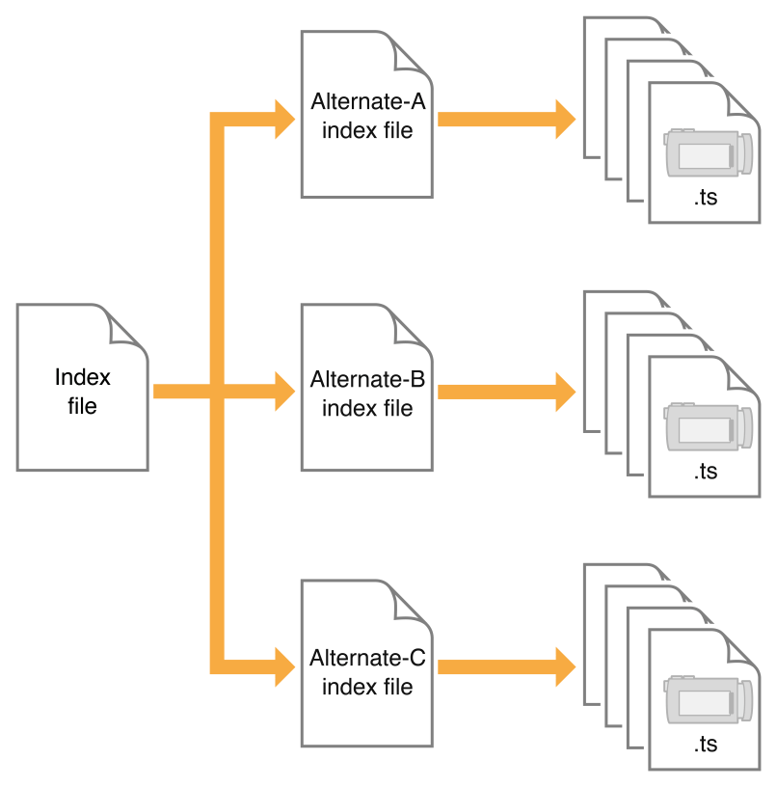
M3U8 Playlist
#EXTM3U
#EXT-X-PLAYLIST-TYPE
#EXT-X-TARGETDURATION
#EXT-X-VERSION
#EXT-X-MEDIA-SEQUENCE
#EXTINF
#EXT-X-STREAM-INF
#EXT-X-ENDLIST
Notes:
The image on the left shows master index file referencing alternate index files depending having different resolution/bitrate. Player begins by fetching the master index file, using it’s .m3u8 URL. The master index file, in turn, fetches alternate index files(based on bandwidth, screen size etc.) which specifies the location of the available media files(corresponding that resolution/bitrate). For the selected stream, the player downloads each available media file in sequence.
EXTM3U: Indicates that the playlist is an extended M3U file. All HLS playlists must start with this tag.
EXT-X-PLAYLIST-TYPE: Provides mutability information that applies to the entire playlist file. This tag may contain a value of either EVENT or VOD. If the tag is present and has a value of EVENT, the server must not change or delete any part of the playlist file (although it may append lines to it). If the tag is present and has a value of VOD, the playlist file must not change.
EXT-X-TARGETDURATION: Specifies the maximum media-file duration.
EXT-X-VERSION: Indicates the compatibility version of the playlist file. The playlist media and its server must comply with all provisions of the most recent version of the IETF Internet-Draft of the HTTP Live Streaming specification that defines that protocol version.
EXT-X-MEDIA-SEQUENCE: Indicates the sequence number of the first URL that appears in a playlist file. Each media file URL in a playlist has a unique integer sequence number. The sequence number of a URL is higher by 1 than the sequence number of the URL that preceded it. The media sequence numbers have no relation to the names of the files.
EXTINF: A record marker that describes the media file identified by the URL that follows it. Each media file URL must be preceded by an EXTINF tag. This tag contains a duration attribute that's an integer or floating-point number that specifies the duration of the media segment in seconds. Suggestion - Always use floating-point EXTINF durations (supported in protocol version 3). This allows the client to minimize round-off errors when seeking within the stream.
EXT-X-STREAM-INF: Indicates that the next URL in the playlist file identifies another playlist file, parameter defines stream’s metadata like BANDWIDTH, AVERAGE-BANDWIDTH, RESOLUTION, CODECS etc.
EXT-X-ENDLIST: Indicates that no more media files will be added to the playlist file.

Slide 13
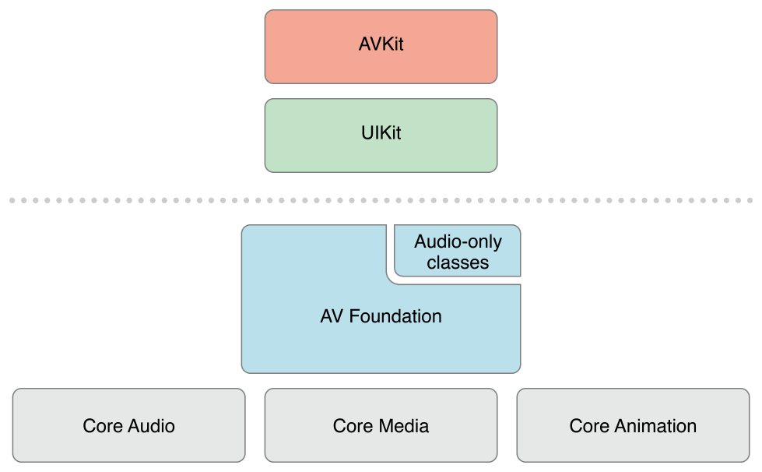
Introduction to AVKit
The AVKit framework provides a high-level interface for playing video content.
Notes:
AVKit is the highest level video framework, then comes AVFoundation(which we will discuss in sometime) and Core Audio, Core Video and Core Media(represent time-based audio-visual assets) layer are the low-level abstractions.
Useful tip(Why we're starting with AVKit) - Always favor the highest level of abstraction available to you. Then, you can drop down to lower levels when what you’ve been using no longer suits your needs.

Slide 14
Demo: Play HLS using AVPlayerViewController
Let’s use AVPlayerViewController to play HLS with system system-supplied playback controls.
Notes:
Demo Duration: 10 min
AVPlayerViewController - An object(subclass of UIViewController) that displays the video content from a player object along with system-supplied playback controls.
AVPlayerViewController makes it easy for you to add media playback capabilities to your application matching the styling and features of the native system players. Since AVPlayerViewController is a system framework class, your playback applications automatically adopt the new aesthetics and features of future operating system updates without any additional work from you.
Note - Do not subclass AVPlayerViewController. Overriding this class’s methods is unsupported and results in undefined behavior.
AVPlayerViewController will give you system playback controls for play/pause, forward/backward, volume/mute, subtitles and cc, videoGravity, seek, duration etc.
AVPlayer is the heart of playing videos on iOS. A player object can start and stop your videos, change their playback rate and even turn the volume up and down.You can think of a player as a controller object that’s able to manage playback of one media asset at a time.

Slide 15
Introduction to AVFoundation
AVFoundation is the full featured framework for working with time-based audiovisual media on iOS, macOS, watchOS and tvOS. Using AVFoundation, you can easily play, create, and edit QuickTime movies and MPEG-4 files, play HLS streams, and build powerful media functionality into your apps.
Notes:
Official Documentation - https://developer.apple.com/av-foundation/
Why AVFoundation - Because AVKit doesn’t provide a lot of customizations like adding gestures/controls for changing rate, selecting quality explicitly, changing brightness etc.
AVFoundation can handle things like:
Capturing video with the built-in camera.
Transcoding between video formats.
Applying filters to a video stream in real-time.

Slide 16
AVFoundation: Main classes for HLS
AVPlayerLayer - This special CALayer subclass can display the playback of a given AVPlayer object i.e. manages a player's visual output.
AVAsset - These are static representations of a media asset. An asset object defines the collective properties of the tracks that comprise it such as duration, creationDate, preferredRate, preferredVolume, playable, metadata etc.
AVPlayerItem - The dynamic counterpart to an AVAsset. This object represents the current state of an asset(playable video) played by the player.
AVPlayer - Controller object used to manage the playback and timing of a media asset.
Notes:
It’s following MVC architecture - AVPlayer(Controller), AVPlayerLayer(View) and AVAsset, AVPlayerItem(Model) classes.

Slide 17
Demo: Custom Player with AVFoundation
Custom Player View with AVPlayerLayer
HLSViewController with controls for play/pause and state management.
Notes:
Demo Duration: 15-20 min
HLSPlayer project contains the following -
HLSPlayerView - It’s a UIView with layer as AVPlayerLayer and player property getter/setter.
HLSViewController - It’s a Controller which takes playerURL as input and have functionalities for play/pause, show/hide/auto-hide controlView, observe timeControlStatus.

Slide 18

Notes:
Let’s break 15 min for a coffee.

Slide 19
Demo: Custom Player with AVFoundation
Video Scrubbing i.e. seekToTime
Forward/Backward 10 seconds
Playback Rate, Volume and Brightness
Video Quality(Bitrate)
Notes:
Demo Duration - 20-25 min
Note - AVPlayer rate (the app's requested playback rate). AVPlayerItem.timebase.rate (the rate at which playback is actually occurring)
For high playback rates you may hear bad audio quality. We are setting AVPlayerItem’s audioTimePitchAlgorithm to .spectral as suggested. - https://forums.developer.apple.com/thread/4797 other solution if you are setting very high rate - https://stackoverflow.com/questions/40506059/jerky-playback-from-avplayer-on-applying-rate-greater-than-2x
For Volume it’s recommended to set AVPlayer’s Volume property without interfacing with System Volume. In case you need to Alter System’s Volume(Not Recommended) then - https://stackoverflow.com/questions/33168497/ios-9-how-to-change-volume-programmatically-without-showing-system-sound-bar-po
Video Quality - There are two ways to adjust video quality
Using preferredPeakBitRate(Not Instant) - https://developer.apple.com/documentation/avfoundation/avplayeritem/1388541-preferredpeakbitrate
Reading M3U8 playlist and parsing stream variants and then replacing playerItem with selected variant - https://github.com/gal-orlanczyk/go-swifty-m3u8

Slide 20
Playing Streams in Queue
AVQueuePlayer - A player used to play a number of items in sequence i.e. create and manage a queue of player items.
Notes:
AVQueuePlayer is a subclass of AVPlayer which can handle multiple player items.

Slide 21
Demo: Playing Streams in Loop
Loop videos by using AVQueuePlayer.
Looping Logic i.e. state management
Notes:
Note - Apple wrote a nifty new class called AVPlayerLooper. This class will take a single player item and take care of all the logic it takes to play that item on a loop. Unfortunately, that doesn’t help here.
Reference - https://www.raywenderlich.com/5191-video-streaming-tutorial-for-ios-getting-started#toc-anchor-007

Slide 22
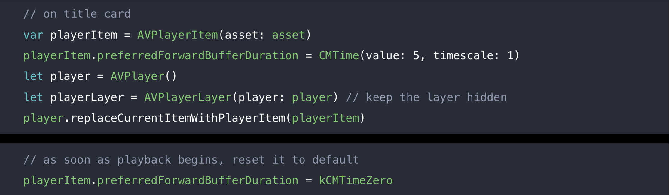
Pre-Caching HLS
preferredForwardBufferDuration - The duration the player should buffer media from the network ahead of the playhead to guard against playback disruption.
Notes:
This property defines the preferred forward buffer duration in seconds. If set to 0, the player will choose an appropriate level of buffering for most use cases. Setting this property to a low value will increase the chance that playback will stall and re-buffer, while setting it to a high value will increase demand on system resources.

Slide 23
Demo: Pre-Caching HLS
Laying out video cards on home screen.
Pre-Cache streams of top video cards/items.

Slide 24
Questions?

Slide 25
Thank You!

